Slide 1
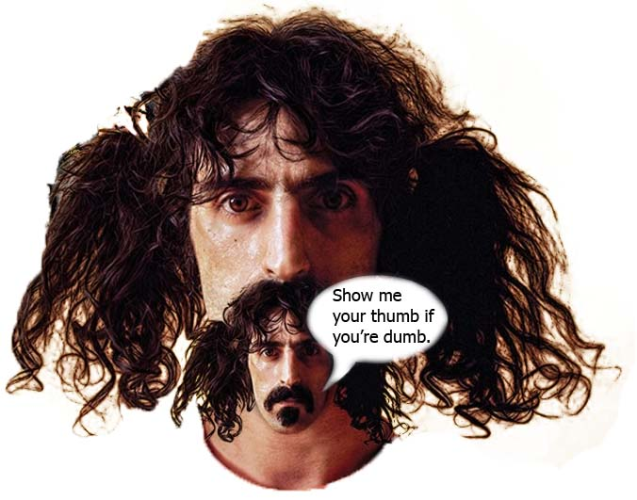
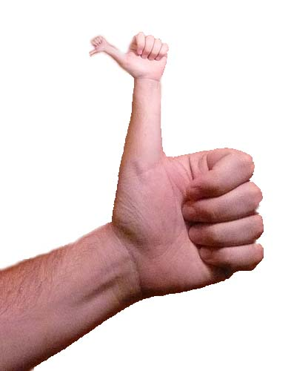
A Line in the Standards
Separating the Helpful from the Harmful

Slide 2
Anthropology of Standards
Typically, the introduction of a standard was to establish a universal notion that “so many of these is worth another many of those.”
If “these” and “those” are “onions” and “carrots” grown in a valley by neighboring people, then the exchange of onions and carrots probably never come down to a fixed number of onions to be exchanged for a fixed number of carrots. This is essentially communism.
If larger societies with more commodities evolve over disjoint geographical areas, weights and measures evolve to establish fairness in the marketplace.
In a human economy, according to Graeber, you the value of a human life becomes a kind of debt that people try commodify, but mostly in ways, or to officially establish, that say the debt of a human life can only be repaid in token measures.
What is commonly referred to as “economy,” is a mixture of commodity marketplace with human labor marketplace. The marketplace of human learning is, I assert, a new and most assuredly unnatural one.

Slide 3
Different Standard Bearers
Commodities
ISO International Standards Organization
NIST National Institute of Standards and Technology
Labor
HRI Human Rights International
NLRB National Labor Relations Board
Education
NCES National Center for Educational Statistics
IES Institute of Education Sciences, carries out the
NAEP National Assessment of Educational Progress (Nation’s Report Card)
Pearson Educational Measurement
ETS Educational Testing System

Slide 4
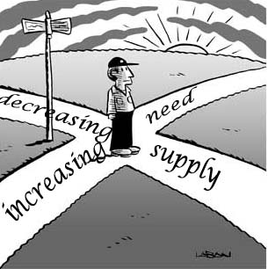
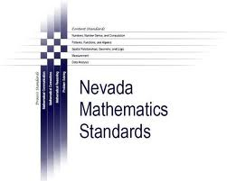
Mathematics Standards
NCTM Standards
AMTYC Crossroads
Beyond Crossroads Shaping the Vision

Slide 5
Crossroads in Mathematics Standards for Introductory College Mathematics Before Calculus (1995)
Two Goals:
Improve mathematics education at two-year colleges and at the lower division level
Encourage more students to study mathematics
Guiding Principles:
Remedial math (the Foundation) is an essential part of two-year math curricula.
Study should focus on what’s meaningful and relevant.
Instruction must involve participation in in-depth projects.
Use technology involving graphics, CAS, spreadsheet, interactive geometry & stats.
Strike a balance among problem-solving, technology, intuition and collaboration.
Work towards increasing students’ option in education and career choices.
Reach out to students who have been traditionally unrepresented in mathematics.
Do not attempt to define “college-level mathematics.”

Slide 6
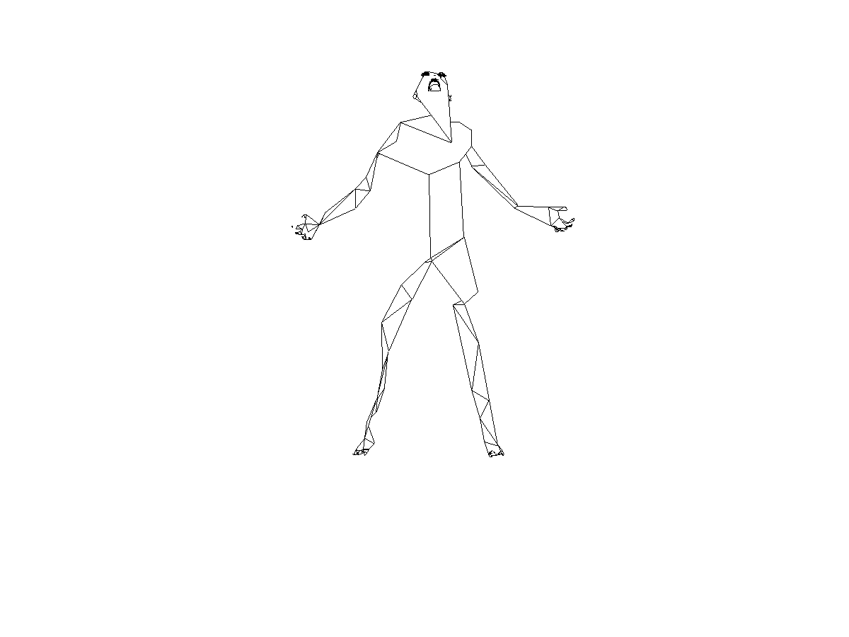
Framework of Three Categories
Standards for Intellectual Development address desired modes of student thinking and represent goals for student outcomes.
Standards for Content provide guidelines for the selection of content that will be taught throughout introductory college mathematics.
Standards for Pedagogy recommend the use of instructional strategies that provide for student activity and interaction and for student constructed knowledge.

Slide 7
I. Standards for Intellectual Development
Desired modes of student thinking and goals for student outcomes:
Problem Solving
Modeling
Reasoning
Connecting with Other Disciplines
Communicating
Using Technology
Developing Mathematical Power

Slide 8
Standard I.1: Problem Solving
Students will engage in substantial problems solving.
Students will use problem-solving strategies that require persistence, the ability to recognize inappropriate assumptions, and intellectual risk taking rather than simple procedural approaches. These strategies should include posing questions; organizing information; drawing diagrams; analyzing situations through trial and error, graphing, and modeling; drawing conclusions by translating, illustrating, and verifying results. The students should be able to communicate and interpret their results.
Emphaziing problem solving will make mathematics more meaningful to students. The problems used should be relevant to the needs and interests of the students in the class. Such problems provide a context as well as a purpose for learning new skills, concepts, and theories.

Slide 9
Standard I.2: Modeling
Students will learn mathematics through modeling real-world situations.
Students will participate in the mathematical modeling of situations from the world around them and use the models to make predictions and informed decisions. Swetz (1991) describes the modeling process as “(1) identifying the problem, including the conditions and constraints under which it exists; (2) interpreting the problem mathematically; (3) employing the theories and tools of mathematics to obtain a solution to the problem; (4) testing and interpreting the solution in the context of the problem; and (5) refining the solution techniques to obtain a ‘better’ answer to the problem under consideration, if necessary.” In some cases, faculty may select problem situations and ask students to collaborate on the development of models. In other cases, students may be asked to evaluate previously developed models. Does the model behave as inteded in that the equations fit the assumptions of the model? How well does the model agree with the real world it is supposed to represent? Does the model perform will on a data set different from the one for which it was developed? Whether students develop their own models or evaluate models that are given to them, they should look beyond how well a proposed model fits a set of data and attempt to provide mathematical or scientific reasons for why the model is valid.

Slide 10
Standard I.3: Reasoning
Students will expand their mathematical reasoning skills as they develop convincing mathematical arguments.
Students will regularly apply inductive and deductive reasoning techniques to build convincing mathematical arguments. They will develop conjectures by using logic and deductive and inductive proof, by framing examples and counterexamples, and by probabilistic and statistical reasoning. They will explore the meaning and role of mathematical identities, support them graphically or numerically, and verify them algebraically or geometrically. Finally, students will judge the validity of mathematical arguments and draw appropriate conclusions.

Slide 11
Standard 1-4: Connecting with Other Disciplines
Students will develop the view that mathematics is a growing discipline, interrelated with human culture, and understand its connections to other disciplines.
If students are to gain a sense that mathematics is a growing discipline, course content must include topics developed since the eighteenth century. Topics such as algorithms needed for computer-based solution processes, the use of probability in understanding chance and randomization, and the applications of non-Euclidean geometries lend themselves to a discussion of who developed the ideas, when they were developed, and what kind of human endeavors motivated their development. Students will need to research sources other than standard mathematics textbooks to determine how mathematics provides a language for the sciences; plays a role in art, music and literature; is applied by economists; is used in business and manufacturing; and has had an impact on history.

Slide 12
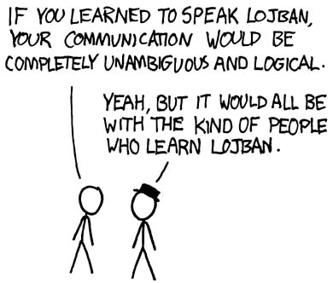
Standard I-5: Communicating
Students wil acquire the ability to read, write, listen to, and speak mathematics.
Students will acquire the skills necessary to communicate mathematical ideas and procedures using appropriate mathematical vocabulary and notation. Students will learn to read and listen to mathematical presentations and arguments with understanding. Furthermore, mathematics faculty will adopt instructional strategies that develop both oral and written communication skills within a context of real applications relevant to the particular group of students. As students learn to speak and write about mathematics, they develop mathematical power and become better prepared to use mathematics beyond the classroom.

Slide 13
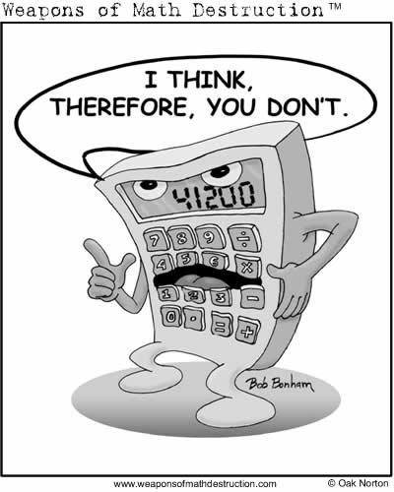
Standard I-6: Using Technology
Students will use appropriate technology to enhance their mathematical thinking and understanding and to solve mathematical problems and judge the reasonableness of their results.
Students will develop an ability to use technology to enhance their study of mathematics in two ways. First, technology can be used to aid in the understanding mathematical principles. Shoaf-Grubbs found that graphing calculators provide “a means of concrete imagery that gives the student new control over her learning environment and over the pace of that learning process. It relieves the need to emphasize symbolic manipulation and computational skills and supports an active exploration process of learning and understanding the concepts behind the mathematics.” In general, students can use technology to test conjectures, explore ideas and verify that theorems are true in specific instances. For example, students can solve quadratic equations and inequalities graphically and then use their knowledge of the graphical solution to clarify the algebraic.

Slide 14
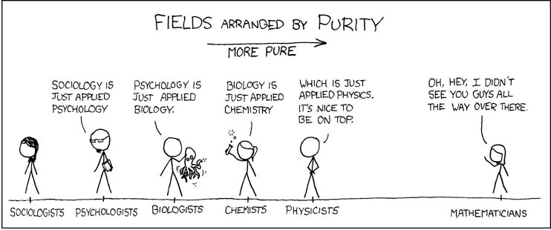
Technical Programs
Contextual learning seems to be the theme here. This is “the mathematics involved beyond the level of sophistication experienced in the Foundation. Mathematics faculty, in cooperation with their colleagues in technical areas or with outside practitioners, should select content that prepares students for the immediate needs of employment. However, at the same time, students should learn to appreciate mathematics and to use mathematics to solve problems in a variety of fields so that they will be able to adapt to change in their career and educational goals.”

Slide 15
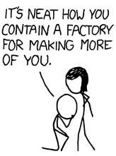
Second, students will use technology naturally and routinely as a tool to aid in the solution of realistic mathematical problems. “Those who use mathematics in the workplace-accountants, engineers, scientists-rarely use paper-and-pencil anymore…Electronic spreadsheets, numerical analysis packages, symbolic computer systems, and sophisticated computer graphics have become the power tools of mathematics in industry” (NRC) In addition, graphing calculators, dynamic geometry software, matrix software, and statistical packages should be included among the technology staples to be used by students.
Technology should be used to enhance the study of mathematics but should not become the main focus of instruction. The amount of time that students spend learning how to use computers and calculators effectively must be compatible with the expected gain in learning mathematics.

Slide 16
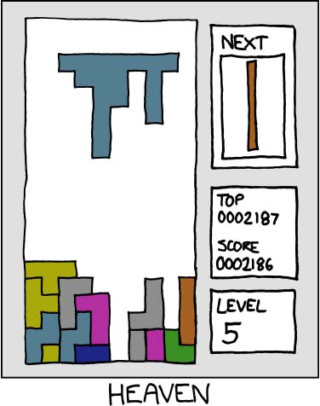
Standard I-7: Developing Mathematical Power
Students will engage in rich experiences that encourage independent nontrivial exploration in mathematics, develop and reinforce tenacity and confidence in their abilities to use mathematics, and inspire them to pursue the study of mathematics and related disciplines.
All students will have opportunities to be successful in doing meaningful mathematics that fosters self-confidence and persistence. They will engage in solving problems that do not have unique answers but, rather, provide experiences that develop the ability to conduct independent explorations. At the same time, they will learn to abstract mathematical principles in order to promote transfer of problem-solving strategies among a variety of contexts and to better appreciate mathematics as a discipline. Furthermore, they will develop an awareness of careers in mathematics and related disciplines and have a vision of themselves using mathematics effectively in their chose fields.

Slide 17
Standards for Content
Mathematics education has traditionally focused on content knowledge. Within this tradition, “knowing mathematics” meant knowing certain pieces of subject matter. This document takes the position that knowing mathematics means being able to do mathematics and that problem solving is the heart of doing mathematics.
Students gain the power to solve meaningful problems through in-depth study of specific mathematics topics. When presented in the context of applications, abstract topics grow naturally out of the need to describe or represent the patterns that emerge. In general, emphasis on the meaning and use of mathematical ideas must increase, and attention to rote manipulation must decrease.
The content standards that follow are not meant to outline a set of courses. Rather, they are strands to be included in an introductory mathematics program in whatever structural form it may take. The specific themes were selected so that adult students can develop the knowledge and skills needed to function as productive workers and citizens as well as be equipped to purse more advanced study in mathematics and other disciplines.

Slide 18
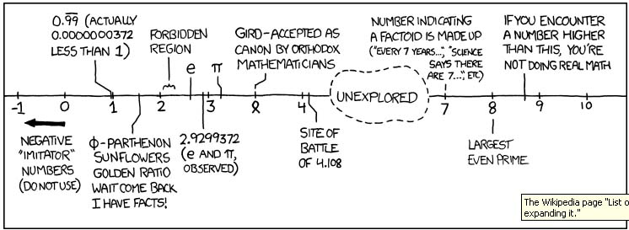
Standard C-1: Number Sense
Students will perform arithmetic operations, as well as reason and draw conclusion from numerical information.
Number sense includes the ability to perform arithmetic operations, to estimate reliably, to judge the reasonableness of numerical results, to understand orders of magnitude, and to think proportionally. Suggested topics include pattern recognition, data representation and interpretation, estimation, proportionality, and comparison.

Slide 19
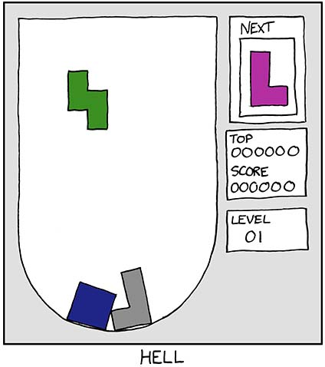
Standard C-2: Symbolism and Algebra
Students will translate problem situations into their symbolic representations and use these representations to solve problems.
Students will move beyond concrete numerical operations to use abstract concepts and symbols to solve problems. Students will represent mathematical situations symbolically and use a combination of appropriate algebraic, graphical, and numerical methods to form conjectures about the problems. Suggested topics include derivation of formulas, translation of realistic problems into mathematical statements, and the solutions of equations by appropriate graphical, numerical, and algebraic methods.

Slide 20
Standard C-3: Geometry
Students will develop a spatial and measurement sense.
Geometry is the study of visual patterns. Every physical object has a shape, so every physical object is geometric. Furthermore, mathematical objects can be pictured geometrically. For example, real numbers are pictured on a number line, force are pictured with vectors, and statistical distributions are pictures with the graphs of curves. Modern dynamic geometry software allows for efficient integration of geometric concepts throughout the curriculum using geometric visualization.
Students will demonstrate their abilities to visualize, compare, and transform objects. Students will develop a spatial sense including the ability to draw one-, two-,l and three-dimensional objects and extend the concept to higher dimensions. Their knowledge of geometry will enable them to determine particular dimensions, area, perimeter, and volume involving plane and solid figures. Suggested topics include comparison of geometric objects (including congruence and similarity), graphing, predictions from graphs, measurement, and vectors.

Slide 21
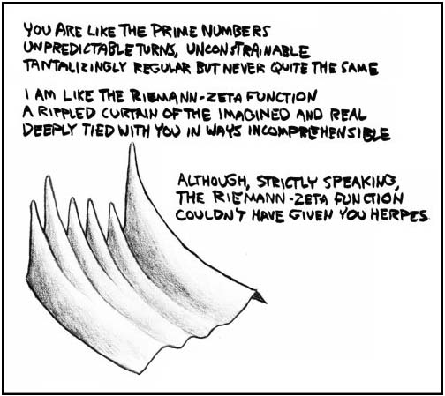
Standard C-4: Function
Students will demonstrate understanding of the concept of function by several means (verbally, numerically, graphically, and symbolically) and incorporate it as s central theme into their use of mathematics.
Students will interpret functional relationships between two or more variables, formulate such relations when presented in data sets, and transform functional information from one representation to another. Suggested topics include generalization about families of functions, use of functions to model realistic problems, and the behavior of functions.

Slide 22
Standard C-5: Discrete Mathematics
Students will use discrete mathematical algorithms and develop combinatorial abilities in order to solve problems of finite character and enumerate sets without direct counting.
Problems situations in the social and behavioral sciences, business, computing and other areas frequently do not exhibit the continuous nature so readily treated by techniques traditionally studied in introductory college mathematics. Rather, the problems involve discrete objects and focus on determining a count. This standard does not imply that recently developed college courses in discrete mathematics are included in introductory college mathematics. Such courses commonly require precalculus or calculus as prerequisites. The standard echoes the recommendation made in the NCTM Standards (1989) and in Reshaping College Mathematics (Siegel); namely, the conceptual framework of discrete mathematics should be integrated throughout the introductory mathematics curriculum in order to improve students’ problem solving skills and prepare them for the study of higher levels of mathematics as well as for their careers. Topics in discrete mathematics include sequences, series, permutations, combinations, recursion, difference equations, linear programming, finite graphs, voting systems, and matrices.

Slide 23
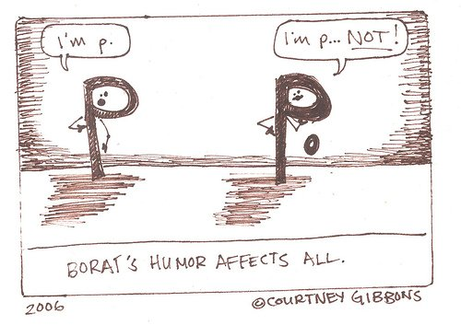
Standard C-6: Probability and Statistics
Students will analyze data and use probability and statistical models to make inferences about real-world situations.
The basic concepts of probability and descriptive and inferential statistics should be integrated throughout the introductory college mathematics curriculum at an intuitive level. Students will gather, organize, display, and summarize data. They will draw conclusions or make predictions from the data and assess the relative chances for certain events happening. Suggested topics include basic sampling techniques, tabulation techniques, creating and interpreting charts and graphs, data transformation, curve fitting, measures of center and dispersion, simulation, probability laws, and sampling distributions.

Slide 24
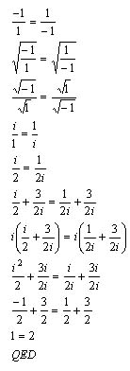
Standard C-7: Deductive Proof
Students will appreciate the deductive nature of mathematics as an identifying characteristic of the discipline, recognize the roles of definitions, axioms, and theorems, and identify and construct valid deductive arguments.
The dependence of mathematics on deductive proof sets it apart as a unique area of human endeavor. While not being the main focus of the instruction in introductory college mathematics, mathematical proofs, including indirect proofs and mathematical induction, will be introduced where they will enhance student understanding of mathematical concepts. Students will engage in exploratory activities that will lead them to form statements of conjecture, test them by seeking counterexamples, and identify and, income instances, construct arguments verifying of disproving the statements.

Slide 25
Standards for Pedagogy
One of the most widely accepted ideas withing the mathematics community is that students should understand mathematics as opposed to thoughtlessly grinding out answers.
But achieving this goal has been like searching for the Holy Grail. There is a persistent belief in the merits of the goal but designing school learning environments that successfully promote understanding has been difficult. (Hiebert & Caprenter,)
Constructivism, which has become a popular theory for linking teaching to student learning, is based on the premise that knowledge cannot be “give” to students. Rather, it is something that they must construct for themselves. However, Resnick and Klopfer (1989( are quick to point out that constructivism does not imply that faculty should get out of the way and let students learn by themselves. All of the traditional questions remain: “how to present and sequence information, how to organize practice and feedback, how to motivate students, how to integrate laboratory activities with other forms of learning, and how to assess learning”. “The goal is to stimulate and nourish students’ own mental elaborations of knowledge and to help them grow in their capacity to monitor and guide their own learning and thinking.”

Slide 26
While constructivist theories may be interpreted differently by different educators and accepted to varying degrees, Brophy and Good (1986) point out that educational research shows that instructional strategies, be they constructivist or not, have a dramatic impact on what students learn. Two themes cut across research finding: “One is that academic success is influenced by the amount of time that students spend on appropriate academic tasks. The second is that students learn more efficiently when their teachers structure new information for them and help them to relate it to what they already know.”
The standards for pedagogy that follow are compatible with the constructivist point of view. They recommend the use of instructional strategies that provide for student activity and student-constructed knowledge. Furthermore, the standards are in agreement with the instructional recommendation contained in Professional Standards for Teaching Mathematics (NCTM 1991).

Slide 27
Standard P-1: Teaching with Technology
Mathematics faculty will model the use of appropriate technology in the teaching of mathematics so that students can benefit from the opportunities it presents as a medium of instruction.
The use of technology is an essential part of an up-to-date curriculum. Faculty will use dynamic computer software to aid students in learning mathematics concepts and will model the appropriate use of technology as tools to solve mathematical problems. The effort spent on teaching students to use technology should be an investment in their future ability to use mathematics. Emphasis should be placed on the use of high-quality, flexible tools that enhance learning and tools they are likely to encounter in future work.
In addition, faculty will use technology as a medium of instruction. Instructional media such as videotapes and computers allow students to progress at their own pace and make mistakes without fearing peer or professional judgment.
The use of technology within the instructional process should not require more time,. In fact, the use of technology, couples with a decreased emphasis in some traditional content areas, should provide the time that is needed to implement the needed reforms in mathematics education.

Slide 28
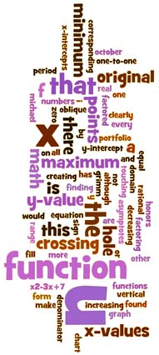
Standard P-2: Interactive and Collaborative Learning
Mathematics faculty will foster interactive learning through student writing, reading, speaking, and collaborative activities so that students can learn to work effectively in groups and communicate about mathematics both orally and in writing.
Mathematical literacy is achieved through an understanding of the signs, symbols and vocabulary of mathematics. This is best accomplished when students have an opportunity to read, write, and discuss mathematical problems and concepts. The following types of experiences will be encouraged in college classrooms: cooperative learning; oral and written reports presented individually or ingroups; writing in journals; open-ended projects; and alternative assessment strategies such as essay questions and portfolios.

Slide 29
Standard P-3: Connecting with Other Experiences
Mathematics faculty will actively involve students in meaningful mathematics problems that build upon their experiences, focus on broad mathematical themes, and build connections within branches of mathematics and between mathematics and other disciplines so that students will view mathematics as a connected whole relevant to their lives.
Mathematics must not be presented as isolated rules and procedures. Students must have the opportunity to observe the interrelatedness of scientific and mathematical investigation and see first-hand how it connects to their lives. Students who understand the role that mathematics has played in their cultures and the contributions of their cultures to mathematics are more likely to persevere in their study of the discipline. Making mathematics relevant and meaningful is the collective responsibility of faculty and producers of instructional materials. Administrators have the responsibility of supporting faculty in this effort.

Slide 30
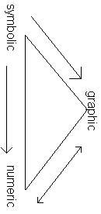
Standard P-4: Multiple Approaches
Mathematics faculty will model the use of multiple approaches—numerical, graphical, symbolic and verbal—to help students learn a variety of techniques for solving problems.
Mathematical power includes the ability to solve many types of problems. Solutions to complex problems require a variety of techniques and the ability to work through open ended problem situations. College mathematics faculty will provide rich opportunities for students to explore complex problems, guide them to solutions through multiple approaches, and encourage both oral and written responses. This will motivate students to go beyond the mastery of basic operations to a real understanding of how to use mathematics, the meaning of the answers, and how to interpret them.

Slide 31
Standard P-5: Experiencing Mathematics
Mathematics faculty will provide learning activities, including projects and apprenticeships, that promote independent thinking and require sustained effort and time so that students will have the confidence to access and use needed mathematics and other technical information independently, to form conjectures from an array of specific examples, and to draw conclusions from general principles.
Mathematics faculty will assign open-ended classroom and laboratory projects, In addition, they will help their institutions form partnerships with area business and industry to develop opportunities for students to have realistic career experiences. Such activities will enable students to acquire the confidence to access needed technical information, and independently use mathematics in appropriate and sensible ways.

Slide 32
Guidelines for Achieving the Standards
Faculty who teach introductory college mathematics must increase the mathematical power of their students. This power increases the students’ options in educational and career choices and enables them to function more effectively as citizens of a global community where the opportunities offered by science and technology must be considered in relation to human and environmental needs. In order to achieve these goals, mathematics education at the introductory level requires reform in curriculum and pedagogy.
The idea that mathematics competence is acquired through a curriculum that is carefully structured to include the necessary content at the appropriate time and the use of diverse instruction strategies is an underlying principle of this document. The following table provide guidance for the change in the content and pedagogy of introductory college mathematics. When items are marked for decreased attention, that does not necessarily mean that they are to be eliminated from mathematics education. Rather, it may mean that they should receive less attention than in previous years, or that their in-depth study should be moved to more advanced courses where they may be immediately applied. On the other hand, increased emphasis must be placed on the item listed in the increased attention column in order to achieve the goals set forth in this document.

Slide 33
GUIDELINES FOR CONTENT
Increased Attention | Decreased Attention
Pattern recognition, drawing inferences | Rote application of formulas
Number sense, mental arithmetic, estimation | Arithmetic drill exercises, routine operations with real numbers
Connections between mathematics and other disciplines | Presentation of mathematics as an abstract entity
Integration of topics throughout the curriculum | Algebra, trigonometry, analytic geometry, and so forth, as separate courses
Discovery of geometrical relationships through the use of models, technology, and manipulatives | Establishing geometric relationships solely through formal proofs
Visual representation of concepts; for example, probability as area under a curve; timelines for annuities and interest; tables for logic and electrical circuits | Rote memorization and use of formulas
Integration of the concept of function across topics within and among courses | Separate and unconnected units on linear, quadratic, polynomial, radical, exponential, and logarithmic functions

Slide 34
GUIDELINES FOR CONTENT (continued)
Increased Attention | Decreased Attention
Analysis of the general behavior of a variety of functions in order to check the reasonableness of graphs produced by graphing utilities | paper-and-pencil evaluation of functions and hand-drawn graphs based on plotting points
Connection of functional behavior (such as where a function increases, decreases, achieves a maximum and/or changes concavity) to the situation modeled by the function | Emphasis on the manipulation of complicated radical expressions, factoring, rational expressions, logarithms, and exponents
Connections among a problem situation, its model as a function in symbolic form, and the graph of that function | “cookbook” problem solving without connections
Modeling problems of chance by constructing probability distributions or by actual experiment | Theoretical development of probability theorems

Slide 35
GUIDELINES FOR PEDAGOGY
Increased Use | Decreased Use
Active involvement of students | Passive listening
Technology to aid in concept development | Paper-and-pencil drill
Problem solving and multistep problems | One-step single-answer problems
Mathematical reasoning | Memorization of facts and procedures
Conceptual understanding | Rote manipulation
Realistic problems encountered by adults | Contrived exercises
An integrated curriculum with ideas developed in context | Isolated topic approach
Multiple approaches to problem solving | Requiring a particular method for solving a problem
Diverse and frequent assessment both in class and outside of class | Tests and a final exam as the sole assessment
Open-ended problems | Problems with only one possible answer
Oral and written communication to explain solutions | Required only short, numerical answers, or multiple-choice responses
Variety of teaching strategies | lecturing

Slide 36
Summary
These standards provide a new vision for introductory college mathematics—a vision whereby students develop intellectually by learning central mathematical concepts in settings that employ a rich variety of instructional strategies. To provide a more concrete illustration of these standards, the Appendix contains a set of problems that bring them to life.
Chapter 3: Interpreting the standards.
Chapter 4: Implications Chapter 5: Implementation Chapter 6: Looking to the Future Appendix: Illustrative Examples References

Slide 37
Beyond Crossroads
Beyond Crossroads extends the three sets of standards from Crossroads in Mathematics with an additional set of standards called Implementation Standards. The content of each of the following chapters focuses on one Implementation Standard.
Student Learning and the Learning Environment
Assessment of Student Learning
Curriculum and Program Development
Instruction
Professionalism

Slide 38
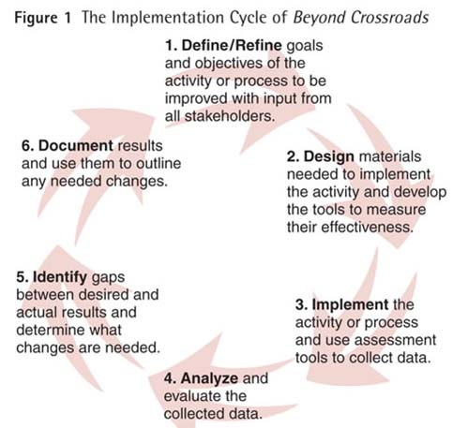

Slide 39
Student Learning and the Learning Environment
Initial Placement into the Mathematics Curriculum
Students will be expected to:
prepare to take a placement test by reviewing test preparation materials supplied by the college
be aware of the implications of placement results.
Departmental/Institutional actions:
assure that mathematics faculty are involved in the design of mathematics placement measures
use multiple measures for initial placement of students into mathematics courses
periodically determine the effectiveness of mathematics placement tests with an empirical study of cut-off scores and student success
place students into the most advanced course appropriate for their program for which they have prerequisite skills.

Slide 40
Learning Styles
In general, learning styles can be categorized according to different personality or cognitive trait characteristics. There are three sensory types of learning styles: auditory (hearing), tactile (doing), and visual (seeing). Other learning styles are extensions of these three basic styles. Most mathematics instructors are visual, abstract, and individual learners. Learning styles for developmental mathematics students are visual, tactile concrete, auditory, and social. (12) Students may exhibit all or many of the characteristics at any one time. Preferences for one style or another may be strong, moderate, or mild.
An individual’s learning style can be identified using available instruments. Some students have a different learning style for mathematics than for other academic subjects, such as English or history. Therefore, to identify a student’s mathematics learning style, it is important to identify and use an inventory specifically designed for mathematics.(13) Once a mathematics learning style has been identified, faculty can help students employ one or more of the following strategies outlined in Table 3 to maximize their learning of mathematics.

Slide 41
Selected Learning Styles Characteristics and Strategies for Students
Learning Style Characteristics: |  | Strategies for Students:
Active/Tactile/ Concrete | Retains and understands information as a result of doing something manual or involving the sense of touch | Use mathematics manipulatives as a concrete demonstration to make sense of a problem situation Draw a picture, make a table, build a physical model of a problem Have students act out a concept
Active/ Social | Retains and understands information as a result of discussing or explaining to others | Participate in study groups Discuss concepts with the instructor and other students
Analytic | Learns concepts and rules from experts | Listen to lectures Watch a demonstration
Dynamic | Learns by exploring and looking for other possibilities for solving problems | Create and complete mathematics projects Use trial and error to find mathematics patterns

Slide 42
Learning Style Characteristics: |  | Strategies for Students:
Global | Learns in large jumps, absorbs material randomly, is able to solve complex problems quickly and in novel ways | Relate new mathematics topics to previous knowledge
Innovative | Learns mathematics by personally relating mathematics to hisself/herself using feelings | Discuss mathematics ideas with others Look for personal meaning in mathematics
Intuitive | Discovers possibilities and relationships, is comfortable with abstractions and mathematical formulations, dislikes memorization and routine calculations | Seek interpretations and theories that provide proofs for theorems or formulas
Reflective | Thinks about information quietly first and prefers to work alone | Incorporate reflection time as a part of study time Practice problems using computer software

Slide 43
Learning Style Characteristics: |  | Strategies for Students:
Sensing/ Common Sense | Learns facts by connecting concepts to real-world situations; prefers to see the usefulness and practical application of mathematics | Consult other sources for specific real-world examples of mathematics concepts and procedures Seek hands-on learning experiences
Sequential | Understands linear steps and follows logical paths to find solutions | Ask instructor to supply steps to solutions for problems
Verbal | Prefers written and spoken explanations | Make summaries or outlines of course material Listen to classmates’ explanations Read written explanations aloud Explain how to solve a problem to a tutor or classmate
Visual | Remembers pictures, diagrams, flow charts, formulas, and procedures | Seek diagrams, schematics, course material that can be viewed Create concept maps Color-code notes with highlighters Make flash cards with color coding

Slide 44
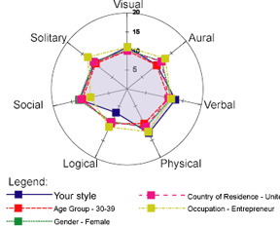
Implementation recommendation
Students and faculty will be aware of different learning styles and implement supportive strategies to maximize student learning in mathematics.
understand student learning styles and become aware of one’s own learning style
help students identify their mathematics learning style(s)
implement multiple instructional strategies to address multiple learning styles.

Slide 45
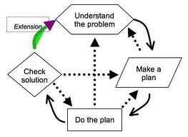
Learning To Be Problem Solvers
Students will be expected to:
recognize that problem solving is an essential skill to be developed or improved in any mathematics course
understand and use a variety of problem-solving strategies.
Faculty actions:
plan and model classroom experiences using multiple problem-solving approaches
provide students with adequate time for planning, monitoring, reflecting, and understanding multiple approaches to solving problems.

Slide 46
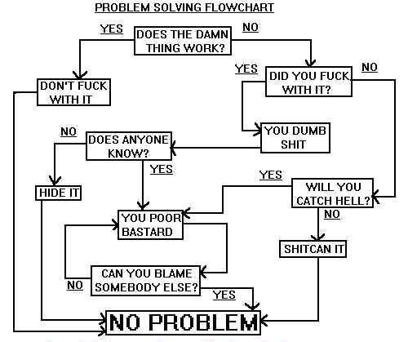

Slide 47
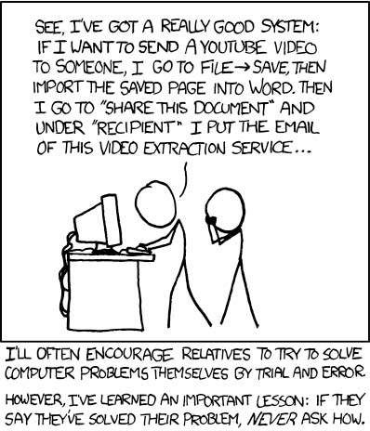

Slide 48
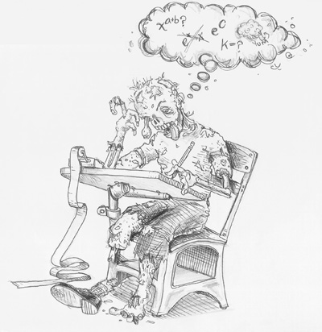
Mathematics Anxiety and Other Factors That Influence Learning
Strategies for students to cope with mathematics anxiety can be grouped into four categories as noted in Table 4. All four categories are beneficial, but Approach Strategies have been shown to be most successful.(25)
Faculty can assist students in overcoming and managing their anxiety by suggesting that students engage in one or more of the following actions.

Slide 49
Strategies for Coping With and Helping to Alleviate Mathematics Anxiety
Approach Strategies involve the active learning of mathematics | Complete homework on time so as not to fall behind. Maintain a regular study schedule and set aside extra study time before examinations. Ask questions in class. Talk with the instructor outside of class when concepts are unclear. Form study groups with other students. Visit a mathematics resource center or tutoring center for extra help. Use supplemental resources, books, or computer-based instruction.
Avoidance Strategies take a break | When frustrated, maintain positive attitudes and remind themselves that they are good students. Participate in sports or exercise to relieve stress.
Social Support sharing with others | Discuss mathematics concepts and experiences with other students. Discuss mathematics concepts and experiences with the instructor, counselor, or advisor.
Relaxation relaxation and self-control techniques | Practice systematic relaxation techniques such as deep breathing, tensing and relaxation, and visualization. Practice long-term relaxation techniques. Replace negative self-talk during homework or test-taking with positive self-talk.

Slide 50
Conclusion
At a standards-based institution, the faculty
clearly define high expectations and communicate these to all students.
are actively involved in understanding and recommending improvements to institutional policies for mathematics placement.
use a variety of instructional methods to address the learning styles of all students.
play an active role in planning and creating the learning environment.
At a standards-based institution, the mathematics department and the institution
provide a learning environment that supports, values, and affirms the diverse needs of all learners.
provide facilities, tutors and staff for mathematics resource centers.
use multiple measures to place students in mathematics courses.
provide professional development regarding learning styles, mathematics anxiety, and multiple problem-solving strategies so that faculty and instructional staff have the skills needed to address the diverse student population and dynamic curriculum.
design and equip classrooms that encourage active learning and use of technology.

Slide 51
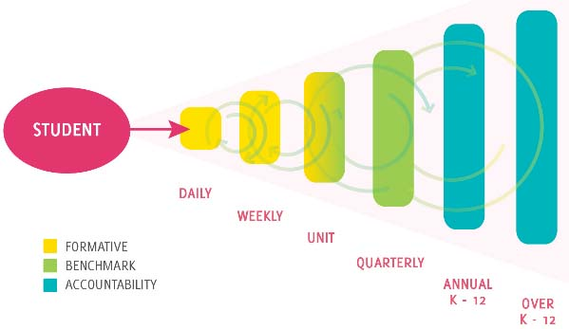
Assessment of Student Learning
Implementation Standard: Assessment of Student Learning
Mathematics faculty will use results from the ongoing assessment of student learning of mathematics to improve curriculum, materials, and teaching methods.
Try to avoid this sort of bs:

Slide 52
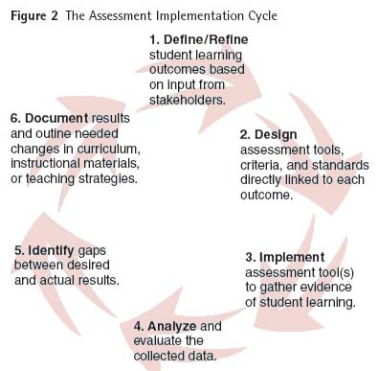

Slide 53
Assessment at Three Levels
Classroom assessment involves individual instructors assessing individual students’ learning outcomes with instructor-developed tools. Many assessments are used throughout the term and changed frequently. Students are informed often about their progress. Individual faculty who use classroom assessment techniques discover how to adapt instruction to address the learning needs of individual students in a specific mathematics class. Faculty make frequent and immediate changes to class activities and methods based on assessment results.
Assessment efforts at the course level provide evidence of student learning and motivate changes beyond the individual classroom. Learning outcomes in individual mathematics classes, in all sections of a particular course, or in sequences of courses or specific programs, are assessed to determine if students are meeting agreed-upon course learning outcomes. A group of faculty teaching intermediate algebra, for example, can collaborate to discover the instructional strategies or materials best suited to help all students learn the relationship between a quadratic equation and its corresponding graph, an agreed-upon course outcome.

Slide 54
Assessing outcomes at the program level is the broadest and most overarching form of assessment discussed in this chapter. Faculty should develop a consensus about the essential student learning outcomes for mathematics courses and programs, as well as the college’s quantitative literacy general education outcomes. Faculty can use the results of program assessment to determine how all courses in a program, mathematics and non-mathematics courses, help students achieve quantitative goals and objectives. In addition, external accrediting agencies may have an impact on mathematics outcomes within programs.
Although classroom assessment should be ongoing, course and program outcomes may be assessed at regular intervals with faculty choosing a different course or program each year. It is important, however, to complete the assessment cycle for the learning outcomes chosen. In addition to collecting data about many outcomes, improvements should be implemented based on an analysis of that data. The following table outlines some of the differences in assessment practices at the three levels.

Slide 55
 | Classroom | Course | Program
Who? | Individual instructors | A group of mathematics faculty who teach a course | Mathematics faculty, possibly as part of an interdisciplinary committee
What? | Individual students’ learning outcomes | Course outcomes (a representative group of students) | Program outcomes (a representative group of students)
Where? | Individual classes | At least a big sample of a course | At the completion of a degree or program
How? | Instructor-developed assessment tools and rubrics | Department-developed tools and rubrics | College-developed tools and rubrics
How many? | Many assessments that are frequently changed for detailed feedback to students | Fewer assessments that remain fairly consistent over time | Fewest assessments that remain fairly consistent over a longer period of time
Levels of measurement? | Many levels to differentiate fine differences in performance | Three levels: exceeds, meets, or does not meet expectations | Three levels: exceeds expectations, meets expectations, does not meet expectations

Slide 56
II. Standards for Pedagogy
Recommend Use of Instructional Strategies that provide for student activity and interaction and for student-constructed knowledge.
Teaching with Technology
Interactive and Collaborative Learning
Connecting with Other Experiences
Multiple Approached
Experiencing Mathematics

Slide 57
Classroom Assessment
Students are observed in the process of learning by collecting frequent feedback on what, how much, and how well they are learning. In addition to enhancing students’ learning, classroom assessments positively affect students’ perceptions and attitudes about the learning process.
Student demonstrations to the class, discovery-oriented activities performed in groups, one-minute papers, or other classroom assessment techniques may be included.
Implementation recommendation: Each faculty member will use multiple classroom assessment techniques as an integral part of instruction to assess student learning and use those results to adjust instructional methods and materials.

Slide 58
Course Assessment
Course outcomes objectives are the same for all sections of a given course, while individual instructors may include additional learning outcomes in class syllabi. Courses taught using a variety of instructional modalities should use equivalent assessment tools to ensure student learning is occurring at a high level regardless of the method of instructional delivery.
A course-based assessment may be administered at the end of a term by all faculty teaching the course.
Course assessment should be used to assess overall student learning of course outcomes, not to evaluate individual instructors. Individual instructors should compare their students’ performance to that of the department to better understand the relationship between specific classroom materials and methods, and student learning. Faculty in the mathematics department as a whole should reflect upon and discuss the assessment results, materials, and processes leading to those results.
Data should also be disaggregated to compare results of diverse student subpopulations.

Slide 59
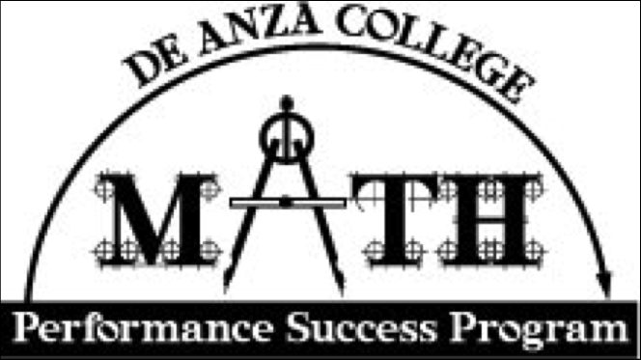
Program Assessment
Program assessment has three components:
assessment of mathematics programs;
assessment of other academic programs that include mathematics learning outcomes; and
assessment of the mathematics component of the college’s general education outcomes.

Slide 61
Implementation recommendation: Mathematics faculty, in collaboration with faculty in other departments, will design an assessment process to measure and improve student learning of mathematics and quantitative literacy in all academic programs.

Slide 62
Actions to support this recommendation
Faculty actions:
identify assessment tools linked to desired student learning outcomes and proceed through the Assessment Implementation Cycle to implement improvements
participate in the development and assessment of general education outcomes in mathematics
determine which of the general education outcomes are met by completing a mathematics course.
Institutional actions:
encourage collaboration among departments regarding instruction and assessment of mathematics outcomes embedded in non-mathematics courses
implement periodic reviews and redesign of student learning outcomes in mathematics.

Slide 63
What Else?
Chapter 6
Curriculum and Program Development
Chapter 7
Instruction
Chapter 8
Professionalism
Chapter 9
Involvement of Stakeholders in Implementation
Chapter 10
Moving from Vision to Reality

Slide 64
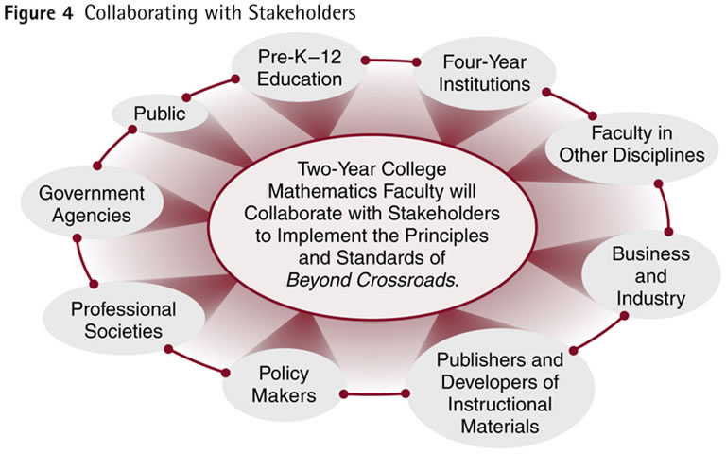

Slide 65
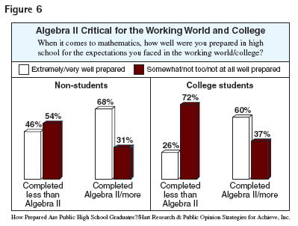
“The academic intensity of the student’s high school curriculum still counts more than anything else in pre-collegiate history in providing momentum toward completing a bachelor’s degree.”(3) And while taking more mathematics in high school is critical, “It’s not merely getting beyond Algebra 2 in high school any more. The world demands advanced quantitative literacy, and no matter what a student’s postsecondary field of study–from occupationally-oriented programs through traditional liberal arts–more than a ceremonial visit to college-level mathematics is called for.”(4)

Slide 66
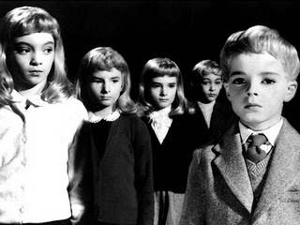
Other Math Standards
California Dept. of Ed. Curriculum Frameworks: Mathmatics
Common Core State Standards Initiative - Mathematics

Slide 67
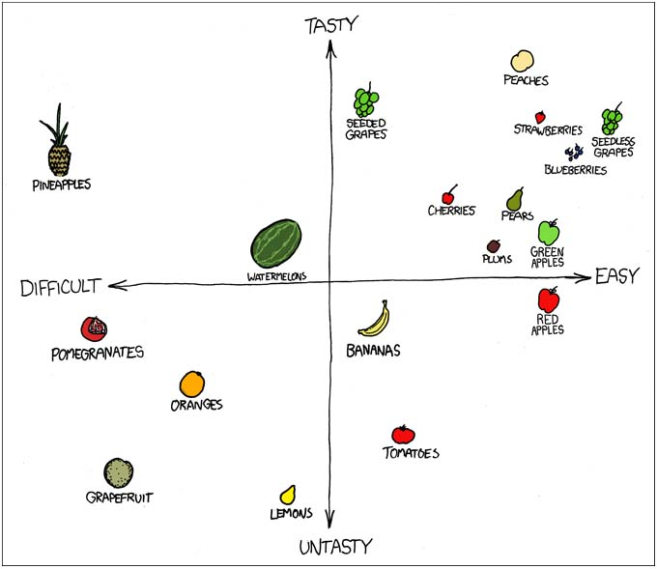
What’s Helpful? Harmful?

